Slide 1
Introducing Classes
Prepared using following Resources:
Herbert Schildt, “Java: The Complete Reference”, Tata McGrawHill Education
E Balagurusamy, Programming with Java - A Tata McGraw Hill Education
https://www.geeksforgeeks.org/java/
https://www.javatpoint.com/java-tutorial
https://www.tutorialspoint.com/java/index.htm
https://www.w3schools.com/java/
By: DIVAKARA .N

Slide 2

Class Fundamentals
Declaring objects
Introducing Methods
Constructors
this keyword
Use of objects as parameter & Methods returning objects
Call by value & Call by reference
Static variables & methods
Garbage collection
Nested & Inner classes.

Slide 3
Class Fundamentals:
Class is the logical construct upon which the entire Java language is built because it defines the shape and nature of an object. It defines a new data type.
The class forms the basis for OOP in Java. Any concept you wish to implement in a Java program must be encapsulated within a class.
Used to create objects of that type. Thus, a class is a template for an object, and an object is an instance of a class.
The two words object and instance used interchangeably.

Slide 4
Class Fundamentals: ...
When you define a class, you declare its exact form and nature. You do this by specifying the data that it contains and the code that operates on that data. While very simple classes may contain only code or only data, most real-world classes contain both.
A class is declared by use of the class keyword.

Slide 5
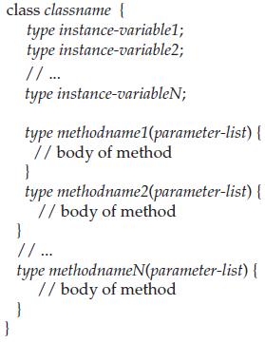
Class Fundamentals: ... A simplified general form
The data, or variables, defined within a class are called instance variables. The code is contained within methods. Collectively, the methods and variables defined within a class are called members of the class. In most classes, the instance variables are acted upon and accessed by the methods defined for that class.
Variables defined within a class are called instance variables because each instance of the class (that is, each object of the class) contains its own copy of these variables. Thus, the data for one object is separate and unique from the data for another.

Slide 6
Class Fundamentals: ...
NOTE:
C++ programmers will notice that the class declaration and the implementation of the methods are stored in the same place and not defined separately. This sometimes makes for very large .java files, since any class must be entirely defined in a single source file.
This design feature was built into Java because it was felt that in the long run, having specification, declaration, and implementation all in one place makes for code that is easier to maintain.

Slide 7
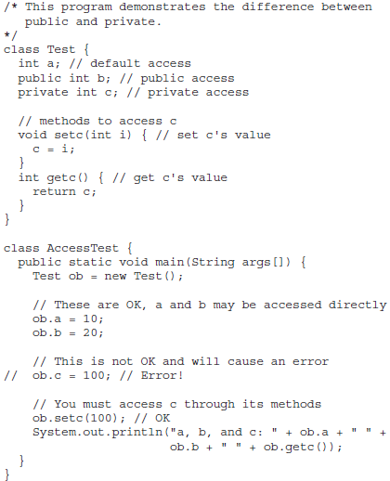
Class Fundamentals: ... Introducing Access Control
Java’s access specifiers are public, private, and protected. Java also defines a default access level.
protected applies only when inheritance is involved.

Slide 8
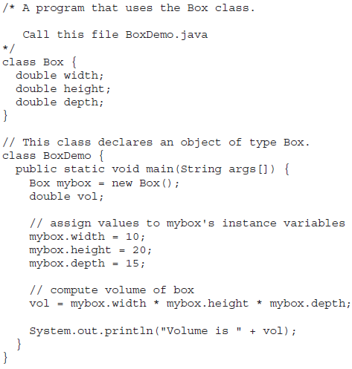
Class Fundamentals: ...
Simple Class: ...
class Box {
  double width;
  double height;
  double depth;
}
Box mybox = new Box();
mybox.width = 100;

Slide 9
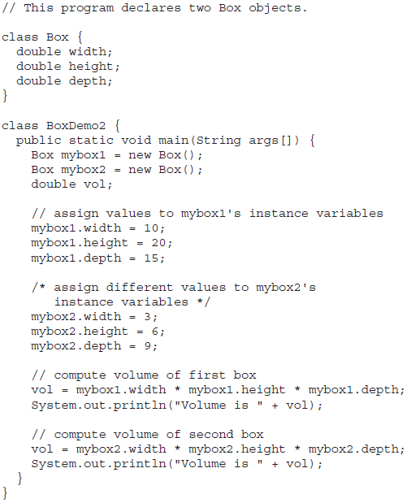
Class Fundamentals: ...
Simple Class: ...

Slide 10
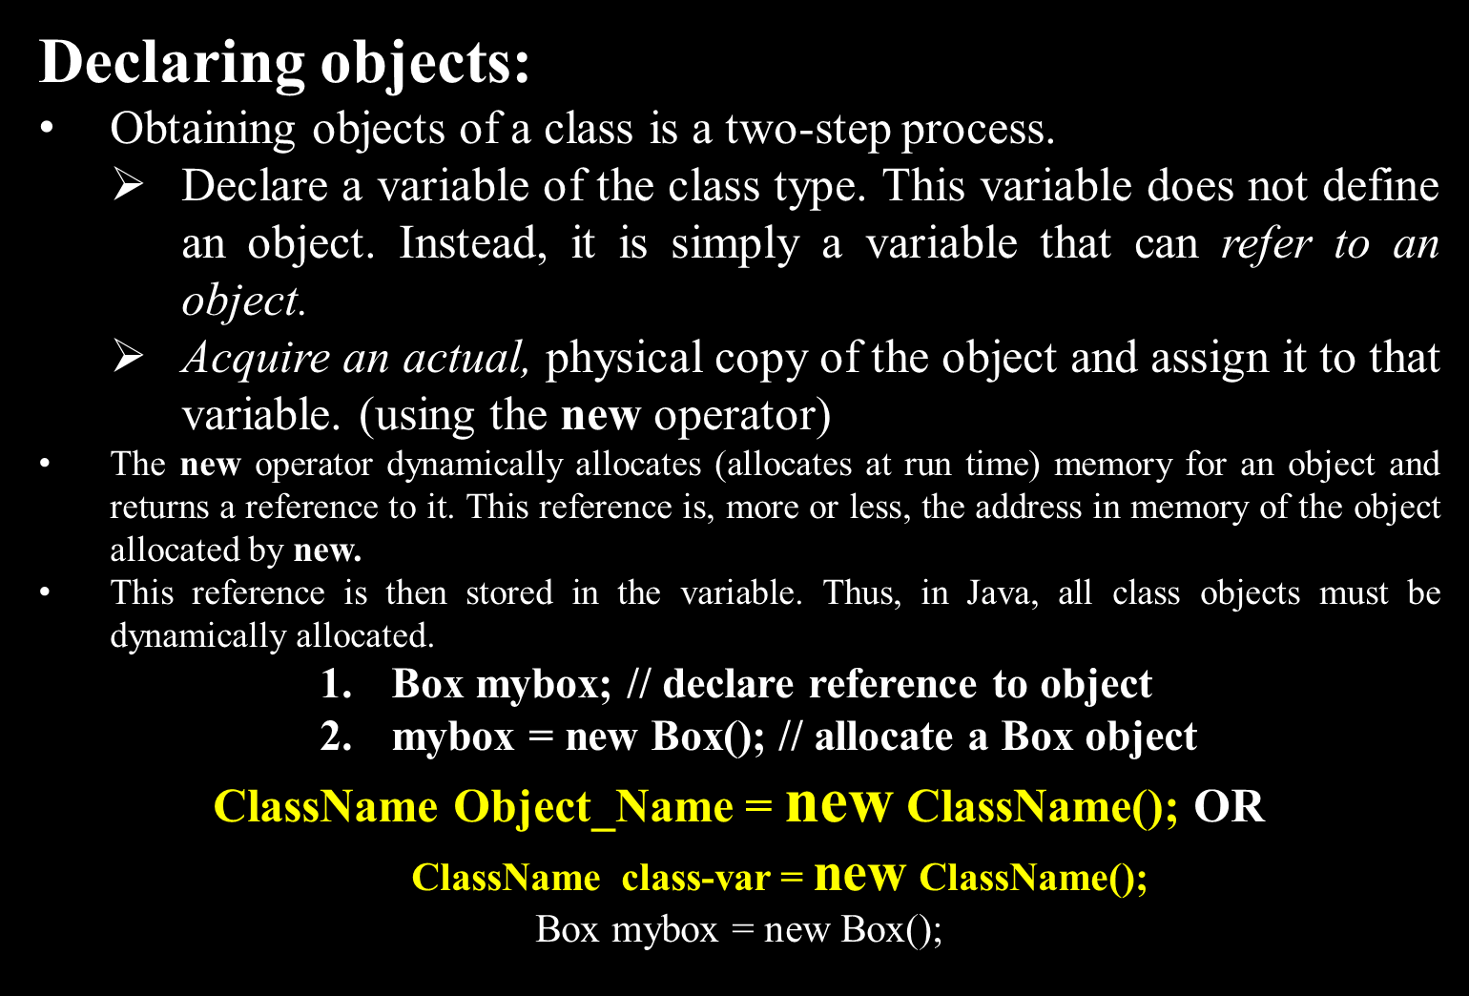

Slide 11
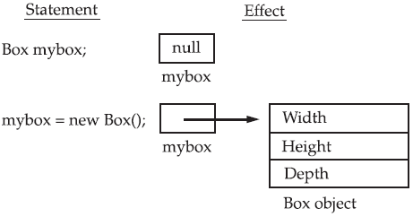
Declaring objects: ...
A Closer Look at new : operator dynamically allocates memory for an object.
General form: class-var = new classname( );
Note: An object reference is similar to a memory pointer. The main difference—and the key to Java’s safety—is that you cannot manipulate references as you can actual pointers. Thus, you cannot cause an object reference to point to an arbitrary memory location or manipulate it like an integer.

Slide 12

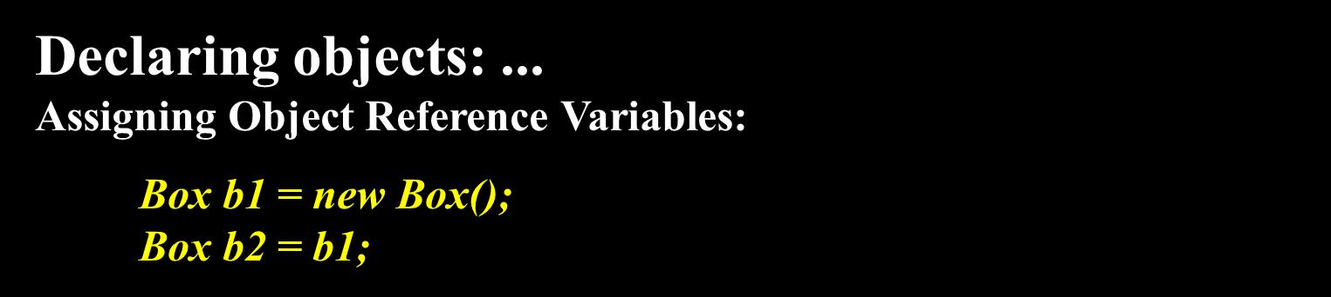
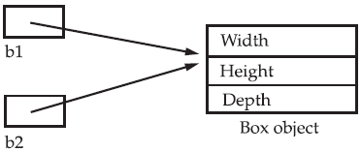
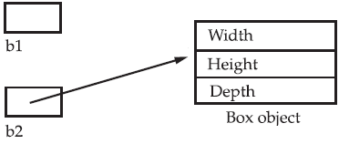
Box b1 = new Box();
Box b2 = b1;
// ...
b1 = null;
REMEMBER When you assign one object reference variable to another object reference variable, you are not creating a copy of the object, you are only making a copy of the reference.

Slide 13
Introducing Methods:
Classes consist of two things: instance variables and methods.
General form:
type name(parameter-list) {
// body of method
}
Here, type specifies the type of data returned by the method. This can be any valid type, including class types that you create. If the method does not return a value, its return type must be void. The name of the method is specified by name. This can be any legal identifier other than those already used by other items within the current scope.
The parameter-list is a sequence of type and identifier pairs separated by commas. Parameters are essentially variables that receive the value of the arguments passed to the method when it is called. If the method has no parameters, then the parameter list will be empty.
Methods that have a return type other than void return a value to the calling routine using the following form of the return statement:
return value;

Slide 14
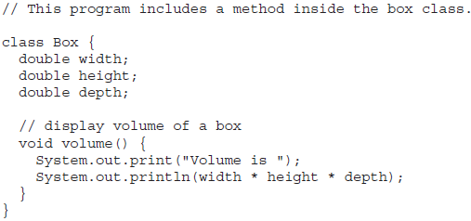
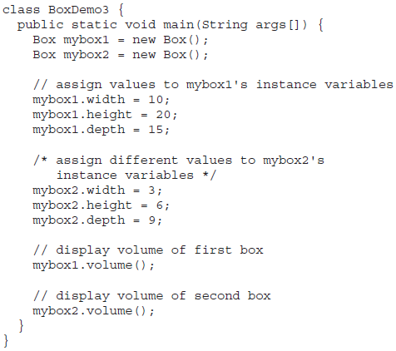
Introducing Methods: ...
Adding a Method to the Box Class:

Slide 15
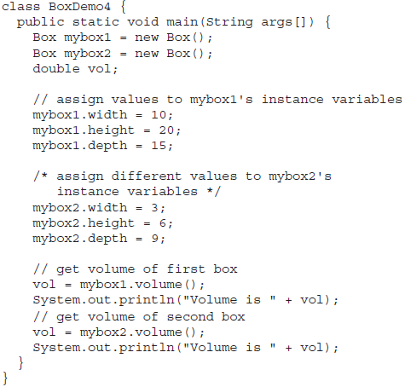
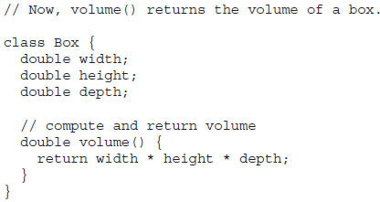
Introducing Methods:...
Returning a Value:
vol = mybox1.volume(); can be replaced by
System.out.println("Volume is " + mybox1.volume());

Slide 16

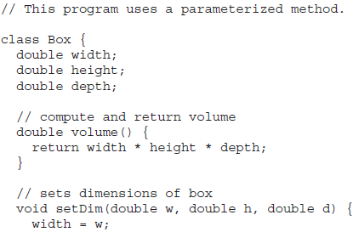
Introducing Methods: ...
Adding a Method That Takes Parameters: Parameters allow a method to be generalized. A parameterized method can operate on a variety of data and/or be used in a number of slightly different situations.
Example:
int x, y;
x = square(5); // x equals 25
x = square(9); // x equals 81
y = 2;
x = square(y); // x equals 4

Slide 17
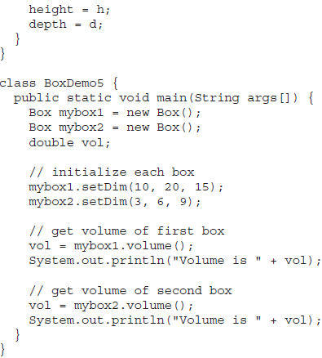
Introducing Methods: ...
Adding a Method That Takes Parameters: ...
Note: The concepts of the method invocation, parameters, and return values are fundamental to Java programming.

Slide 18
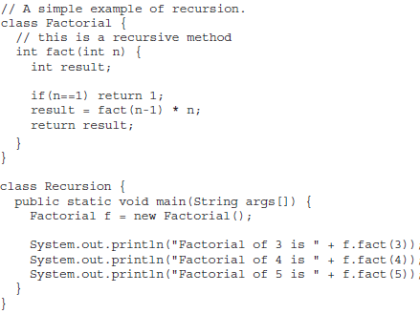
Introducing Methods: ... Recursion:
Java supports recursion. Recursion is the process of defining something in terms of itself. As it relates to Java programming, recursion is the attribute that allows a method to call itself. A method that calls itself is said to be recursive.

Slide 19
Introducing Methods: ... Overloading
In Java it is possible to define two or more methods within the same class that share the same name, as long as their parameter declarations are different.
Method overloading is one of the ways that Java supports polymorphism.
Method overloading is one of Java’s most exciting and useful features.
Java uses the type and/or number of arguments as its guide to determine which version of the overloaded method to actually call. Thus, overloaded methods must differ in the type and/or number of their parameters.

Slide 20
Introducing Methods: ... Overloading ...
  class Calculation{
    void sum(int a, int b){
    System.out.println(a+b);
    }
    void sum(int a, int b, int c){
    System.out.println(a+b+c);
    }
    public static void main(String args[]){
      Calculation obj = new Calculation();
      obj.sum(10,10,10);
      obj.sum(20,20);
    }
  }
Method Overloading by changing the no. of arguments

Slide 21
Introducing Methods: ... Overloading ...
class Calculation2{
void sum(int a, int b){
System.out.println(a + b);
}
void sum(double a, double b){
System.out.println(a + b);
}
public static void main(String args[]){
  Calculation2 obj = new Calculation2();
  obj.sum(10.5,10.5);
  obj.sum(20,20);
}
}
Method Overloading by changing data type of argument

Slide 22
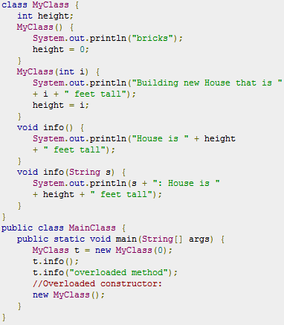
Introducing Methods: ... Overloading ...
Method/Constructor Overloading by changing number of argument

Slide 23
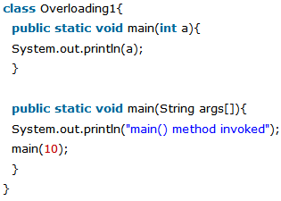
Introducing Methods: ... Overloading ...
Can we overload main() method?

Slide 24
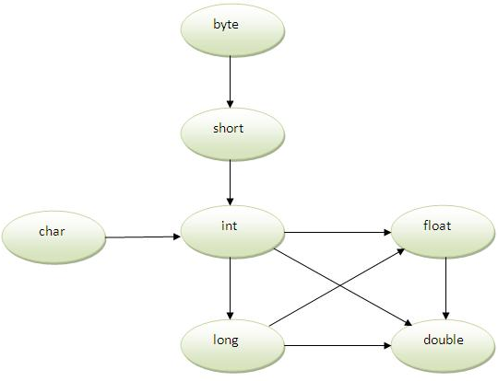

Introducing Methods: ... Overloading ...
Method Overloading and Type Promotion: One type is promoted to another implicitly if no matching datatype is found.
byte can be promoted to short, int, long, float or double. The short datatype can be promoted to int,long,float or double. The char datatype can be promoted to int, long, float or double and so on.

Slide 25
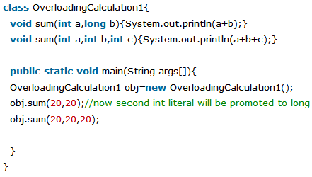
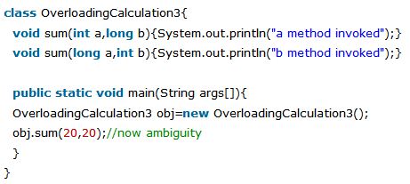
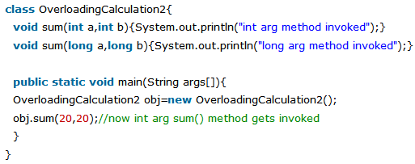
Introducing Methods: ... Overloading ...
Method Overloading and Type Promotion:...

Slide 26
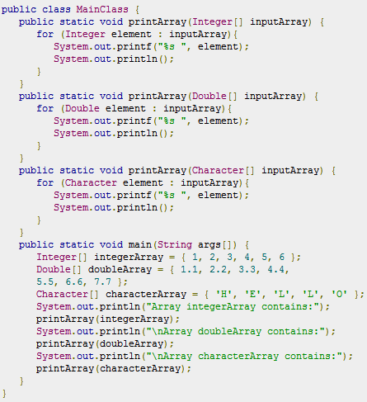
Introducing Methods: ... Overloading ...

Slide 27
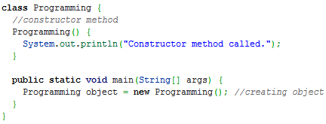
Constructors:
It can be tedious to initialize all of the variables in a class each time an instance is created. It would be simpler and more concise to have all of the setup done at the time the object is first created. Because the requirement for initialization is so common, Java allows objects to initialize themselves when they are created. This automatic initialization is performed through the use of a constructor.
A constructor initializes an object immediately upon creation. It has the same name as the class in which it resides and is syntactically similar to a method. Once defined, the constructor is automatically called immediately after the object is created, before the new operator completes. Constructors look a little strange because they have no return type, not even void.

Slide 28
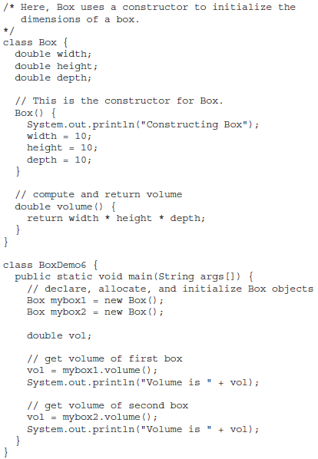
Constructors: ...
class-var = new classname( );
Box mybox1 = new Box();
When you do not explicitly define a constructor for a class, then Java creates a default constructor for the class.
The default constructor automatically initializes all instance variables to zero.
Once you define your own constructor, the default constructor is no longer used.

Slide 29
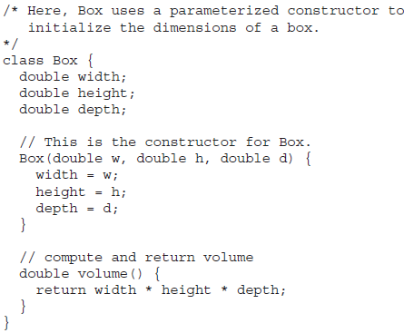
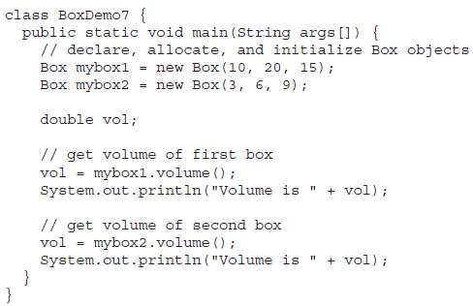
Constructors: ... Parameterized Constructors

Slide 30
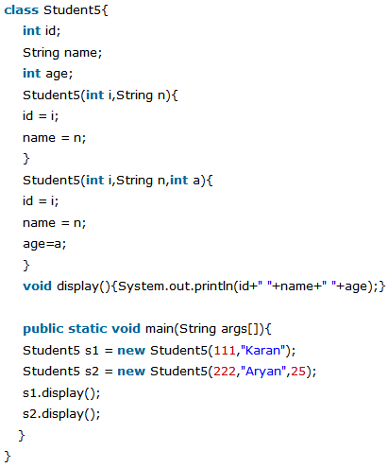
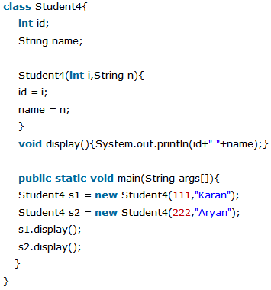
Constructors: ... Overloaded Constructors

Slide 31
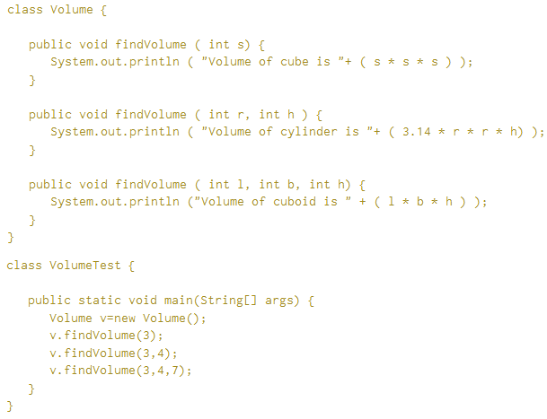
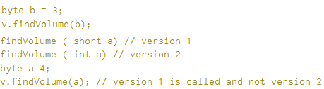
Constructors: ... Overloaded Methods...

Slide 32
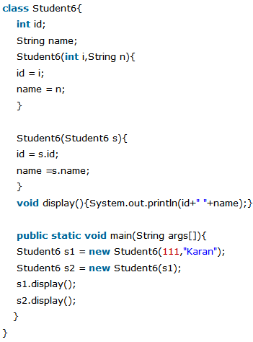
Constructors: ... Overloaded Constructors...
Java’s Copy Constructor

Slide 33
this keyword:
Sometimes a method will need to refer to the object that invoked it.
this can be used inside any method to refer to the current object. That is, this is always a reference to the object on which the method was invoked. You can use this anywhere a reference to an object of the current class’ type is permitted.
// A redundant use of this.
Box(double w, double h, double d) {
  this.width = w;
  this.height = h;
  this.depth = d;
}
Instance Variable Hiding
// Use this to resolve name-space collisions.
Box(double width, double height, double depth) {
  this.width = width;
  this.height = height;
  this.depth = depth;
}

Slide 34
this keyword: ...
A word of caution: The use of this in such a context can sometimes be confusing, and some programmers are careful not to use local variables and formal parameter names that hide instance variables. Of course, other programmers believe the contrary—that it is a good convention to use the same names for clarity, and use this to overcome the instance variable hiding. It is a matter of taste which approach you adopt.

Slide 35
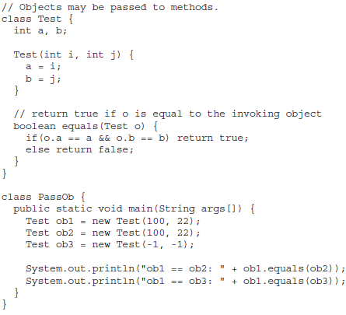
Use of objects as parameter & Methods returning objects
So far, we have only been using simple types as parameters to methods. However, it is both correct and common to pass objects to methods.

Slide 36
Use of objects as parameter & Methods returning objects
One of the most common uses of object parameters involves constructors.
Frequently, you will want to construct a new object so that it is initially the same as some existing object.
Example….

Slide 37
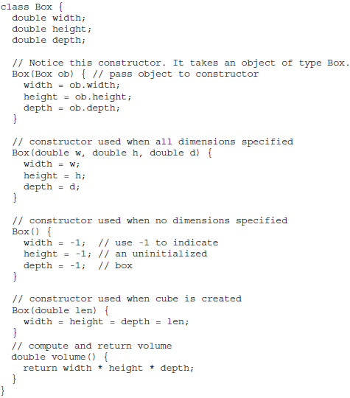
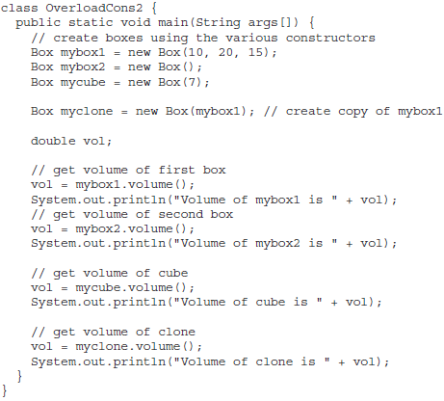
Use of objects as parameter & Methods returning objects

Slide 38
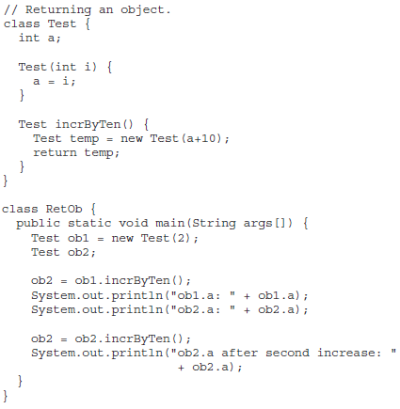
Use of objects as parameter & Methods returning objects
Returning Objects: A method can return any type of data, including class types that you create.

Slide 39
Call by value & Call by reference:
A Closer Look at Argument Passing
In general, there are two ways that a computer language can pass an argument to a subroutine: call-by-value and call-by-reference.
call-by-value: Copies the value of an argument into the formalparameter of the subroutine. Therefore, changes made to the parameter of the subroutine have no effect on the argument.
call-by-reference: a reference to an argument (not the value of the argument) is passed to the parameter. Inside the subroutine, this reference is used to access the actual argument specified in the call. This means that changes made to the parameter will affect the argument used to call the subroutine.
REMEMBER When a primitive type is passed to a method, it is done by use of call-by-value. Objects are implicitly passed by use of call-by-reference.

Slide 40
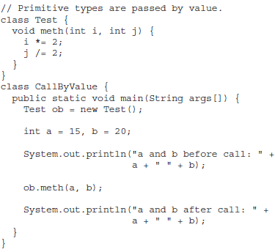
Call by value & Call by reference: ...
A Closer Look at Argument Passing ...
In Java, when you pass a primitive type to a method, it is passed by value. Thus, what occurs to the parameter that receives the argument has no effect outside the method.

Slide 41
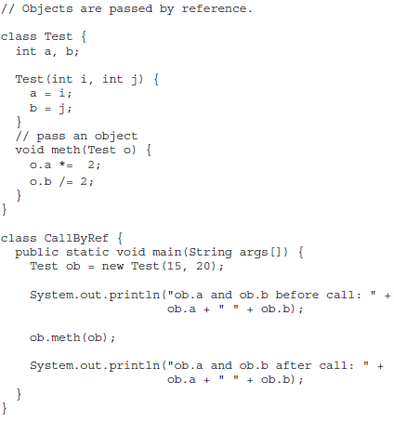
Call by value & Call by reference: ...
A Closer Look at Argument Passing ...
The objects are passed to methods by use of call-by-reference. Changes to the object inside the method do affect the object used as an argument.

Slide 42
Varargs: Variable-Length Arguments:
Beginning with JDK 5, Java has included a feature that simplifies the creation of methods that need to take a variable number of arguments. This feature is called varargs and it is short for variable-length arguments.
A method that takes a variable number of arguments is called a variable-arity method, or simply a varargs method.
Situations that require that a variable number of arguments be passed to a method are not unusual.
For example, a method that opens an Internet connection might take a user name, password, filename, protocol, and so on, but supply defaults if some of this information is not provided.

Slide 43
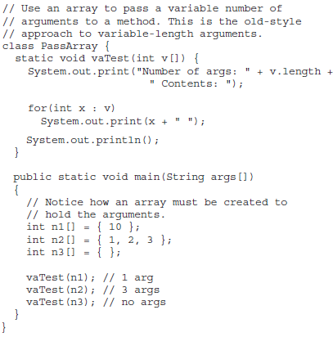

Varargs: Variable-Length Arguments:...

Slide 44
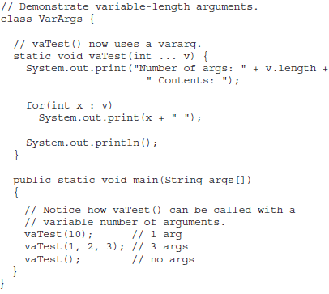
Varargs: Variable-Length Arguments:...
Avariable-length argument is specified by three periods (...)
Eg: vaTest( ) is written using a vararg: static void vaTest(int ... v) {

Slide 45
Varargs: Variable-Length Arguments:...
A method can have “normal” parameters along with a variable-length parameter. However, the variable-length parameter must be the last parameter declared by the method.
Eg: This method declaration is perfectly acceptable:
int doIt(int a, int b, double c, int ... vals) {
Remember, the varargs parameter must be last.
For example, the following declaration is incorrect:
int doIt(int a, int b, double c, int ... vals, boolean stopFlag) { // Error!
int doIt(int a, int b, double c, int ... vals, double ... morevals) { // Error!

Slide 46
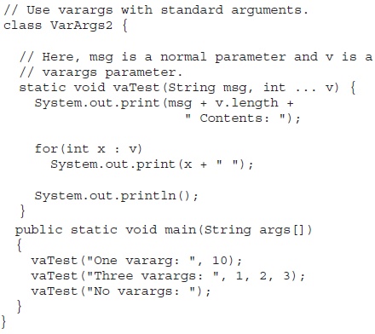
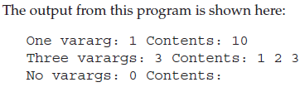
Varargs: Variable-Length Arguments:...

Slide 47
Static Variables & Methods:
Understanding static
Normally, a class member must be accessed only in conjunction with an object of its class. However, it is possible to create a member that can be used by itself, without reference to a specific instance.
To create such a member, precede its declaration with the keyword static. When a member is declared static, it can be accessed before any objects of its class are created, and without reference to any object.
Instance variables declared as static are, essentially, global variables. When objects of its class are declared, no copy of a static variable is made. Instead, all instances of the class share the same static variable.

Slide 48
Static Variables & Methods: ...
Understanding static...
Methods declared as static have several restrictions:
  They can only call other static methods.
  They must only access static data.
  They cannot refer to this or super in any way. (The keyword super relates to inheritance)
If you need to do computation in order to initialize your static variables, you can declare a static block that gets executed exactly once, when the class is first loaded.

Slide 49
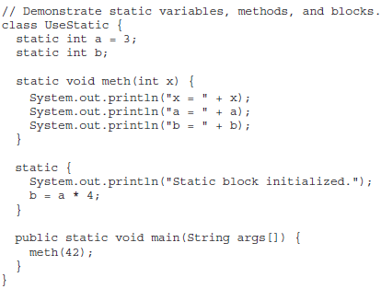
Static Variables & Methods: ...
Understanding static...

Slide 50
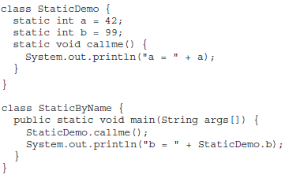
Static Variables & Methods: ...
Understanding static...
Outside of the class in which they are defined, static methods and variables can be used independently of any object.
classname.method( )

Slide 51
Introducing final:
A variable can be declared as final. it prevents its contents from being modified. This means that you must initialize a final variable when it is declared.
For example:
    final int FILE_NEW = 1;
    final int FILE_OPEN = 2;
    final int FILE_SAVE = 3;
    final int FILE_SAVEAS = 4;
    final int FILE_QUIT = 5;
It is a common coding convention to choose all uppercase identifiers for final variables.
Variables declared as final do not occupy memory on a per-instance basis. Thus, a final variable is essentially a constant.

Slide 52
Garbage collection:
Since objects are dynamically allocated by using the new operator, you might be wondering how such objects are destroyed and their memory released for later reallocation. The technique that accomplishes this is called garbage collection.
It works like this: when no references to an object exist, that object is assumed to be no longer needed, and the memory occupied by the object can be reclaimed.
Garbage collection only occurs sporadically (if at all) during the execution of your program. It will not occur simply because one or more objects exist that are no longer used.

Slide 53
Garbage collection: ...
The finalize( ) Method:
Sometimes an object will need to perform some action when it is destroyed.
For example, if an object is holding some non-Java resource such as a file handle or character font, then you might want to make sure these resources are freed before an object is destroyed.
Java provides a mechanism called finalization. By using finalization, you can define specific actions that will occur when an object is just about to be reclaimed by the garbage collector.

Slide 54
Garbage collection: ...
The finalize( ) Method:...
To add a finalizer to a class, you simply define the finalize( ) method. The Java run time calls that method whenever it is about to recycle an object of that class. Inside the finalize( ) method, you will specify those actions that must be performed before an object is destroyed.
The garbage collector runs periodically, checking for objects that are no longer referenced by any running state or indirectly through other referenced objects. Right before an asset is freed, the Java run time calls the finalize( ) method on the object.
The finalize( ) method has this general form:
protected void finalize( ) {
// finalization code here
}

Slide 55
Garbage collection: ...
The finalize( ) Method:...
It is important to understand that finalize( ) is only called just prior to garbage collection.
It is not called when an object goes out-of-scope. This means that you cannot know when—or even if—finalize( ) will be executed.
Therefore, your program should provide other means of releasing system resources, etc., used by the object. It must not rely on finalize( ) for normal program operation.

Slide 56
Nested & Inner classes:
It is possible to define a class within another class; such classes are known as nested classes.
The scope of a nested class is bounded by the scope of its enclosing class.
Eg: If class B is defined within class A, then B does not exist independently of A.
A nested class has access to the members, including private members, of the class in which it is nested. However, the enclosing class does not have access to the members of the nested class.
A nested class that is declared directly within its enclosing class scope is a member of its enclosing class. It is also possible to declare a nested class that is local to a block.

Slide 57
Nested & Inner classes: ...
There are two types of nested classes: static and non-static
Static: A static nested class is one that has the static modifier applied. Because it is static, it must access the members of its enclosing class through an object. That is, it cannot refer to members of its enclosing class directly. Because of this restriction, static nested classes are seldom used.
Non-static: The most important type of nested class is the inner class. An inner class is a non-static nested class. It has access to all of the variables and methods of its outer class and may refer to them directly in the same way that other non-static members of the outer class do.

Slide 58
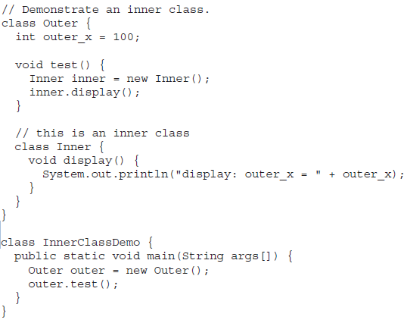
Nested & Inner classes: ... Inner/Non-Static classes

Slide 59
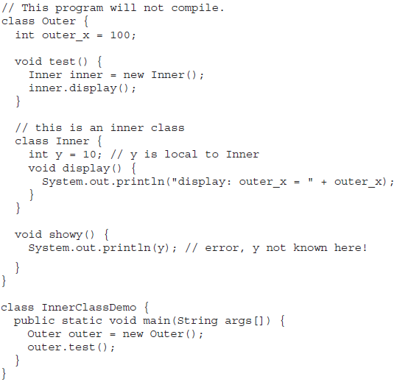
Nested & Inner classes: ... Inner/Non-Static classes...

Slide 60
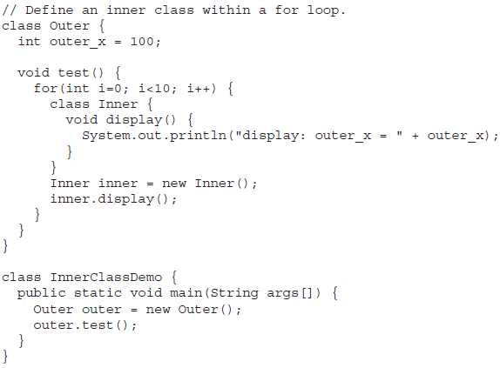
Nested & Inner classes: ... Inner/Non-Static classes...
While nested classes are not applicable to all situations, they are particularly helpful when handling events.
One final point: Nested classes were not allowed by the original 1.0 specification for Java. They were added by Java 1.1

Slide 61
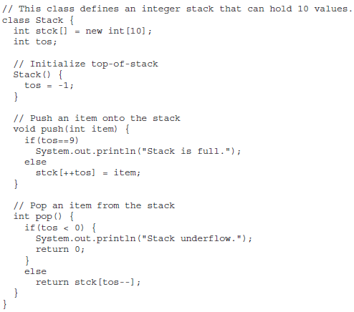
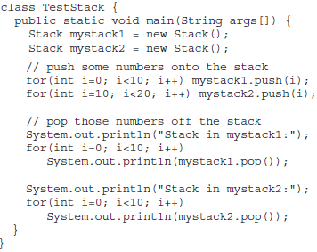
The Stack class: An example...

Slide 62
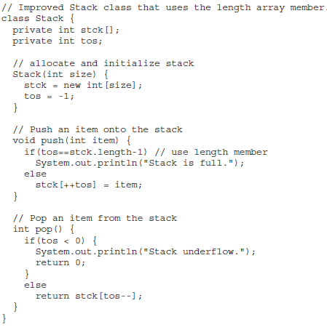

The Stack class: An example...Modified

